Slide 1
BUSINESS PLAN
Make Fortune by Selling Anything
Unlocking the Secrets Behind Success
Ajay T Shaju
S7 | Artificial Intelligence & Data Science

Slide 2
OUTLINE
The Company
The Product
Three Important Marketing Strategies
My Findings

Slide 3
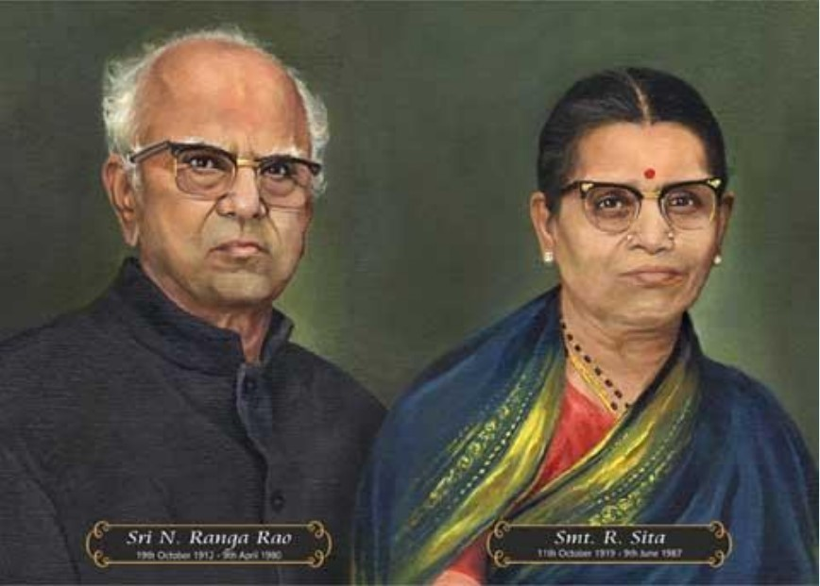
The Company
Name: NR Group (N Ranga Rao)
Founded on: 1948; Mysore (now Mysuru), Karnataka
Business: Selling Essential Oils, Fragrances & Incense Sticks
Business Type: Agro-Based, Environment
N Ranga Rao
Founder, NR Group
Notes:
Till now you may not get a connection of what i am talking about, but this doubt will exist only till you see this

Slide 4
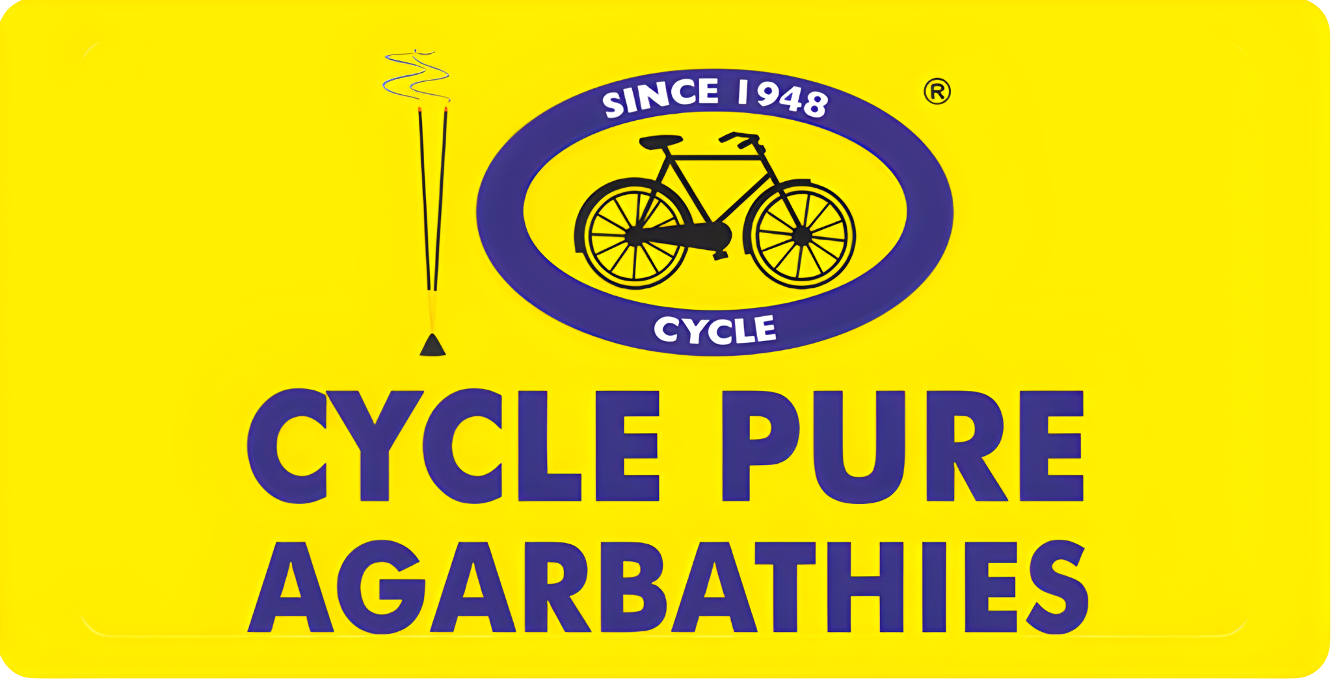
The Product
Notes:
A household name

Slide 5
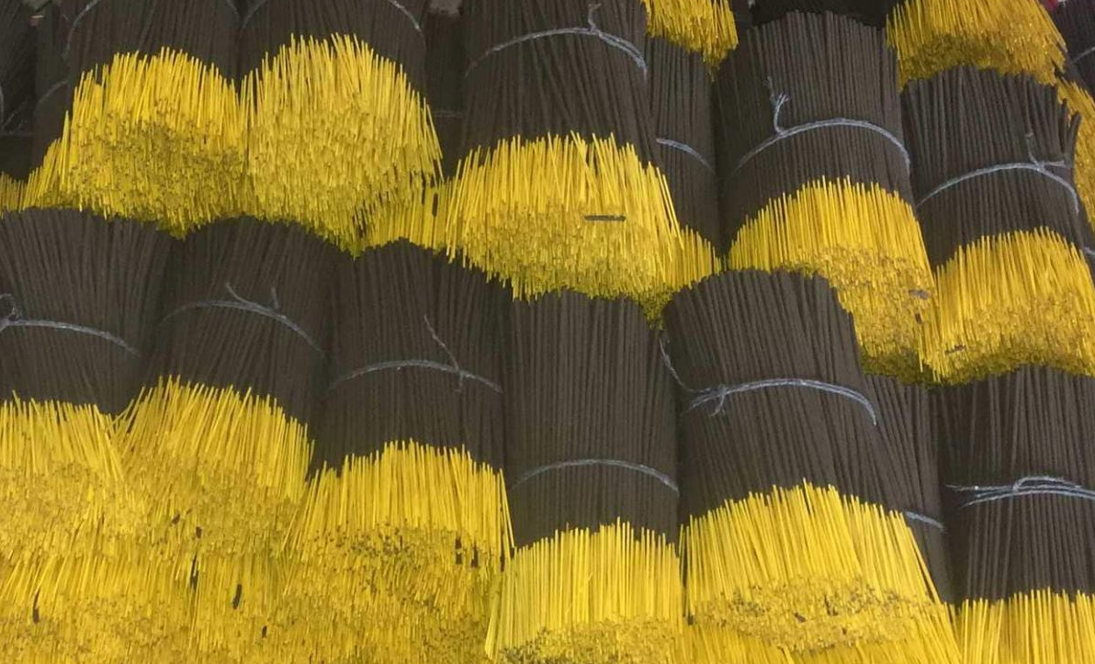
Why Agarbathies?
N Ranga Rao liked agarbathies in general
Importance of Agarbathies for older generations.
Cut-off or reuse anything, but offering to god should be number 1
Welcoming ‘Lakshmi’(Goddess of Wealth) to home
Cleaning the home
Prayers, and
A great fragrance
Sandal Woods were very affordable in Mysore

Slide 6
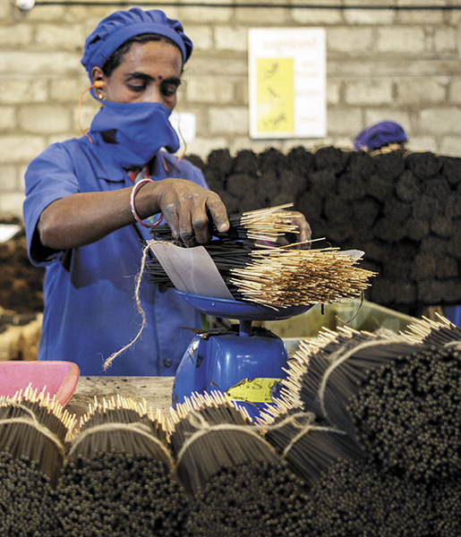
Why Agarbathies? – Market Gap (Opportunity)
Quantity over quality.
100 incense sticks for ₹1
Nobody bothered about the fragrance of incense sticks.
Others spend money on packaging(tin cans)
NR Rao bought 3 books from Italy for ₹600
Learned the composition of perfume mixing(perfumery)
Notes:
Now lets see the amazing market strategies of NR Groups

Slide 7

Marketing Strategies
Making the product speak and act for us.
NR Rao lighted 2 agarbathies near shops
People coming to shops ask for agarbathis, Shop owner doesn’t have them
Shop owner negotiated with NR Rao
Giving two incense sticks to shop owners
Family getting attracted to the smell of incense
HIGH SALE PITCH DONE!
Shelves of Mysore Shops need Cycle Agarbathies than it needs the shelves.
Notes:
Next, there were some irregularities in the sales of cycle agarbathis

Slide 8
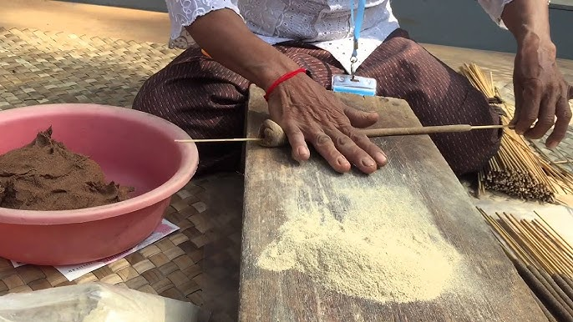
Marketing Strategies
2. NR Rao’s son Murthy came into business (after graduating in perfumery)
Cycle Agarbathies sales were irregular at that time
Murthy directly engaged with the seller and customers
Got the reasons as monotonous(repetitive) smell of Cycle Agarbathies
Murthy after through research, introduced the 3 in 1 Cycle Agarbathies
Mixed 3 types of fragrances in 1 packet

Slide 9

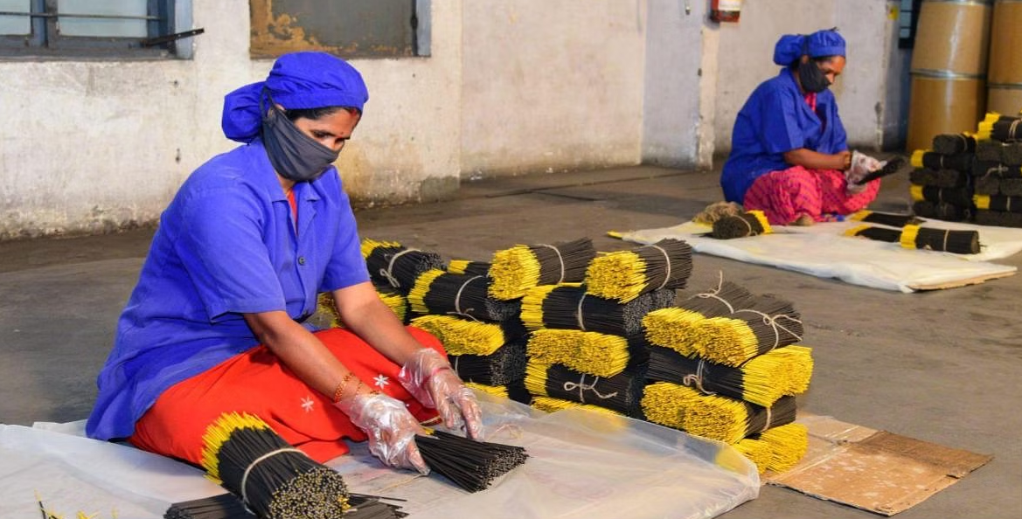
Marketing Strategies
3. Murthy’s son Arjun Ranga came into business
Taken Cycle Agarbathies to different sponsorships (Cricket, TV Ads)
First Agarbathies brand to advertise on TV
Taken the profit of company from ₹400 Crores (2007) → ₹1500 Crores (2022)
Notes:
Now lets see some of my own finding, that answers why the cycle pure agarbathis got up to this level

Slide 10
My Findings
Yellow color of packing.
Cycle bell sound and ‘GOD EXIST’ word.
Power of words – cycle, pure.

Slide 11
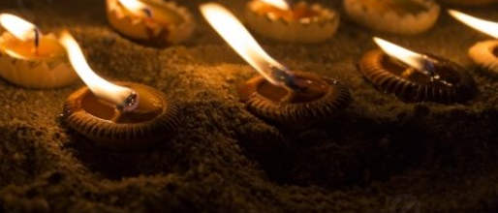

Yellow color of packing
Yellow color has more intensity, visible from a long distance
Taxi, School, College buses use yellow color for this reason
Yellow color will remain in our brain for a long time
Color of fire – light for gods

Slide 12

Cycle bell sound and ‘GOD EXIST’ word
Sound remain in brain
Sound memory may last only for 2-4 seconds.
The memory refreshes (we remembers) when hearing similar sounds.
‘God Exist’ points to their leads and business

Slide 13
Power of Words – Cycle, Pure
Familiar with the word ‘CYCLE’
Easier to remember
Patanjali – More likely to forget
A deity who is said to have authored the Yoga Sutras
We may more familiar with ‘Cycle Pure Agarbathies’ than ‘Cycle Agarbathies’
Word Pure gives a sense of cleanliness
People will connect cycle agarbathies with purity and cleanliness
Notes:
conclusion

Slide 14
Conclusion
With right time, right strategies, and perfect quality.
In addition to reasonable price
Make Fortune by Selling Anything
in
INDIA
Notes:
Jai hind

Slide 15
Thank You

